Slide 1

Module 2 contd
Mathematics Foundations of Cryptography
Part I: Divisibility, Euclidean Algorithm, Modular Arithmetic, Congruence,
2.<number>
Copyright © The McGraw-Hill Companies, Inc. Permission required for reproduction or display.

Slide 2
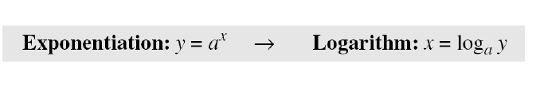
Exponentiation and Logarithm
In cryptography, common modular operation is exponentiation.
Often we need to calculate y = a^{x} mod n
RSA cryptosystem uses modular exponentiation for both encryption/decryption with very large exponents.
Adversary can use logarithm to attack. It is hard to reverse the exponentiation for larger modulus
Most computer have no operator to efficiently compute exponentiation and need for efficient algorithms

Slide 3
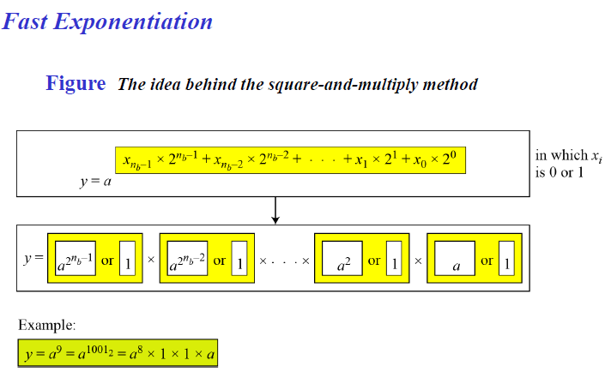
Unlike traditional algorithms which uses multiplication
Treat exponents as binary number of n_{b} bits.
y is product of n_{b} terms
Continously square the base a, a², a⁴ … a^{2nb-1},
If corresponding bit is 0, term is not included in multiplication process ;
If the bit is 1, it is included in multiplication process

Slide 4
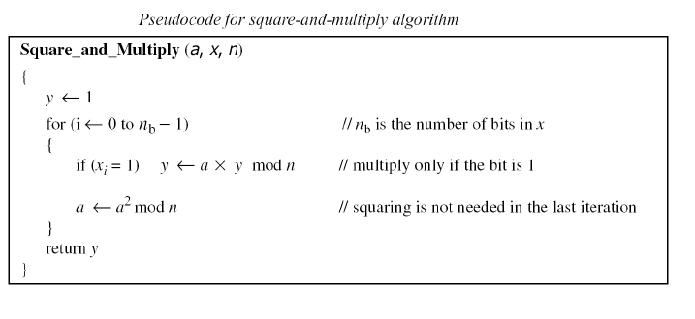
Value of bit is 1, multiples current base with previous value of result.
It then squares the base for the next iteration.

Slide 5
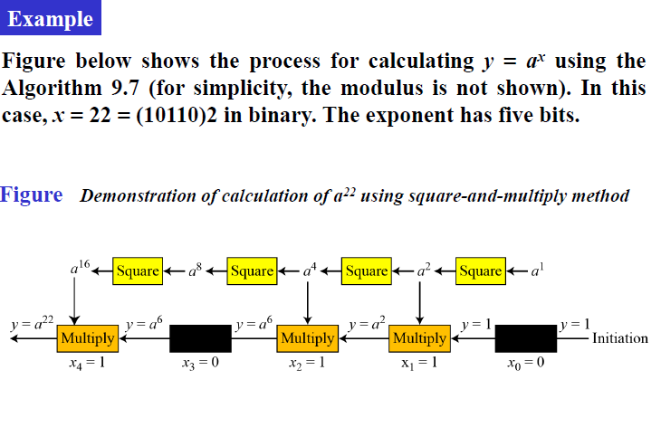
Value of y is gradually built until y=a²²

Slide 6
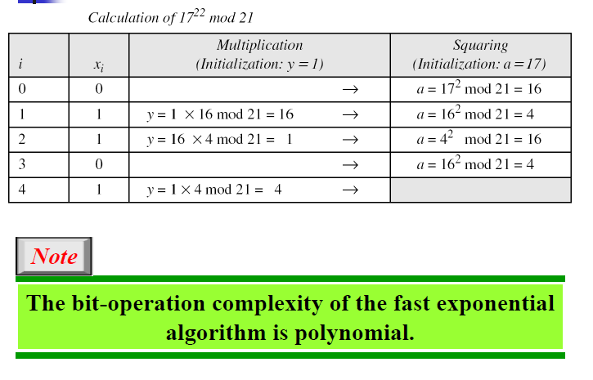
Bit operation complexity is O(n_{b}) as maximum of 2n_{b} arithmetic operations

Slide 7
Logarithm
Can you compute
2⁵ = ?
Can you compute
3? = 129140163
Answer – 17
We can also write 5 = log₂(32) ; 17 = log₃ (129140163)

Slide 8
Logarithm
Traditional
_{In general}
p^{i} = q
i = log_{p}(q)

Slide 9
Modular Logarithm
Can you compute this
9 = 3? mod 12
Now can you tell
26067 =14^{i} (mod 29867)
Given exponent, easy to find result. Inverse of it finding exponent is hard

Slide 10
Modular Logarithm
Can you compute this
9 = 3⁴ mod 12
Now can you tell
26067 =14¹² (mod 29867)
Given exponent, easy to find result. Inverse of it finding exponent is hard

Slide 11
Modular Logarithm
Can you compute this
9 = 3⁴ mod 12
4 = dlog_{3,12} (9)
Now can you tell
26067 =14¹² (mod 29867)
12 = dlog_{14,29867}(26067)

Slide 12
Modular Logarithm
In general
a = b^{i} (mod m)
i = dlog _{b,m} (a)

Slide 13
Modular Logarithm
Compute
2⁵ mod 3 = 2
4⁵ mod 11 = 3
Can you compute this
8 = 5^{i} mod 13 – Determine i
Or i = dlog_{5,13} (8)

Slide 14
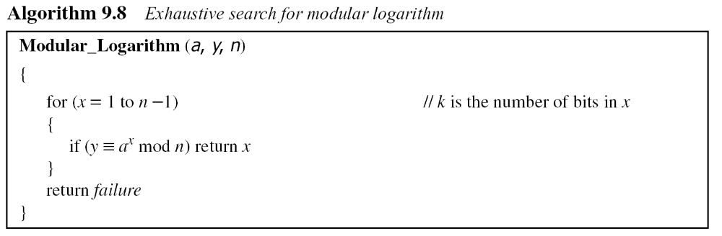
9.6.2 Logarithm
In cryptography, we also need to discuss modular logarithm.
Exhaustive Search
9.<number>

Slide 15
9.6.2 Logarithm
Exhaustive Search
5⁰ mod 13 = 1
5¹ mod 13 = 5
5² mod 13 =12
5³ mod 13 = 8
9.<number>

Slide 16
9.6.2 Logarithm
5³ mod 13 = 8
Can you check this one
? = 5⁷ mod 13
And
? = 5¹¹ mod 13
9.<number>

Slide 17
9.6.2 Logarithm
5³ mod 13 = 8
5⁷ mod 13 = 8
5¹¹ mod 13 = 8
Getting the same result for different values of i (exponents)
For Discrete Logarithms used in cryptography, we need unique / distinct result – duplicates not allowed
9.<number>

Slide 18
9.6.2 Logarithm
We should consider cases only when dlog gives us a unique answer
Only then we can use dlog in our cryptographic algorithms
How to know “i” will give a distinct value or not?
9.<number>

Slide 19
Primitive Roots
a = b^{i} (mod m)
i = dlog_{b,m}(a)
We can get a unique value of i if b is a primitive root of prime module m
What is a primitive root?
9.<number>

Slide 20
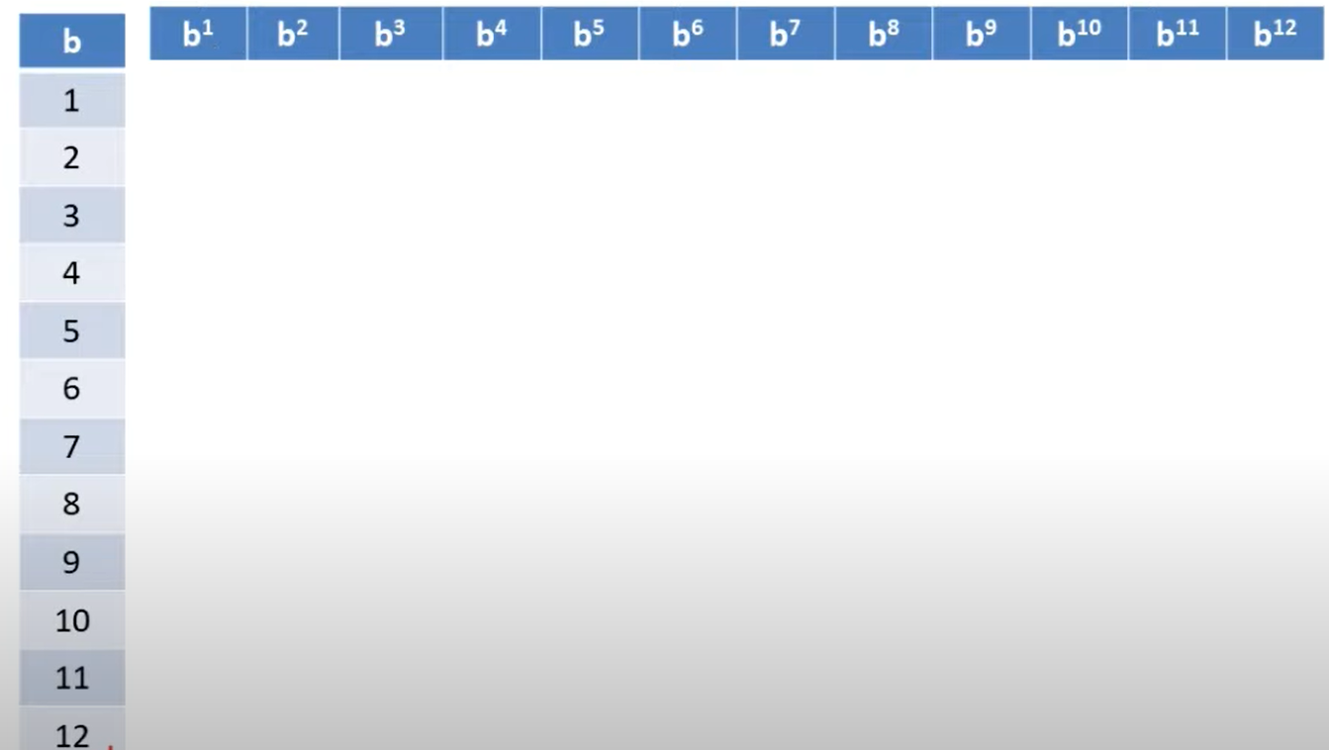
Primitive Root
a = b^{i} (mod m) (Consider m = 13)
9.<number>
b from 1 to m-1 ; i = 1 to m-1 , b^{i} mod m

Slide 21
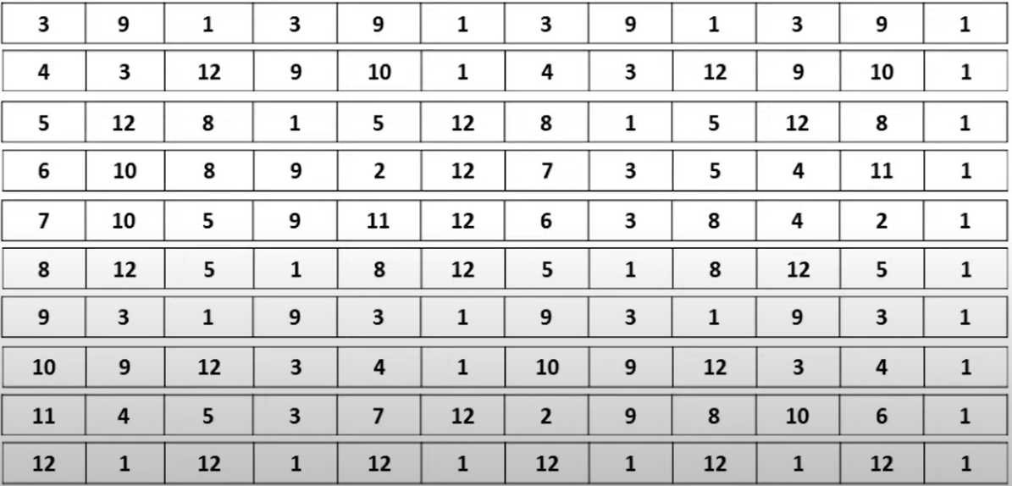
Primitive Root
a = b^{i} (mod m) (Consider m = 13)
9.<number>
b from 1 to m-1 ; i = 1 to m-1 , b^{i} mod m

Slide 22
Primitive Root
a = b^{i} (mod m) (Consider m = 13)
9.<number>
b from 1 to m-1 ; i = 1 to m-1 , b^{i} mod m

Slide 23
Primitive Roots
a = b^{i} (mod m)
i = dlog_{b,m}(a)
2. 6,7, 11 are the primitive root of prime module 13
9.<number>

Slide 24
Primitive Roots
Exercise : Check if 5 is a primitive root of mod 7 ?
i = dlog_{b,m}(a)
(or) a = b^{i} (mod m)
Determine i when a,b and m are given
Finding Discrete Logarithm for Large numbers will be difficult
9.<number>

Slide 25
Primitive Roots
Determine i when a,b and m are given
Finding Discrete Logarithm for Large numbers will be difficult
? = dlog_{17,2111}(1922)
1922 = 17^{i} (mod 2111)
Ans = 12 (small nos insecure, but)
Think of numbers 2048 bits in size?
9.<number>

Slide 26
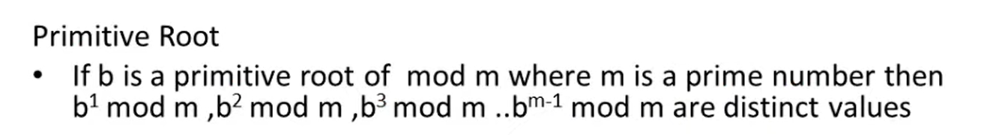
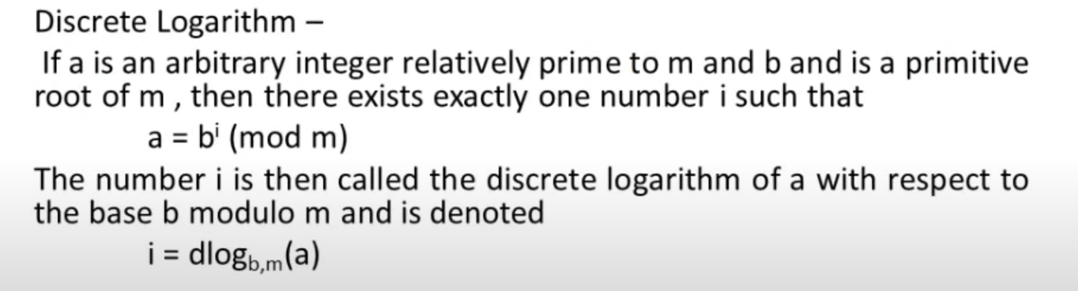
Primitive Roots
9.<number>

Slide 27
Discrete Logarithms
Properties of Multiplicative Groups
Finite Multiplicative Group
In cryptography, we often use the multiplicative finite
group: G = <Zn*, ×> in which the operation is multiplication.
The set Zn* contains those integers from 1 to n−1 that are relatively prime to n;
the identity element is e = 1.
Note that when the modulus of the group is a prime,
we have G = <Zp*, ×>.
9.<number>

Slide 28
9.6.2 Continued
Order of a group
the order of a finite group, |G|, to be the number of elements in the group G.
In G = <Zn∗, ×>, it can be proved that the order of group is φ(n). How to calculate φ(n), when n can be factored into primes??
9.<number>

Slide 29
9.6.2 Continued
Order of a group
What is the order of group G = <Z₂₁∗, ×>?
|G| = φ(21) = φ(3) × φ(7) = 2 × 6 =12.
There are 12 elements in this group: 1, 2, 4, 5, 8, 10, 11, 13, 16, 17, 19, and 20. All are relatively prime with 21.
9.<number>

Slide 30
9.6.2 Continued
Order of an Element
The order of an element, ord(a) in G = <Z_{n}*, ×>
The order of an element, a, is the smallest integer i such that
a^{i} ≡ e (mod n). The identity element e is 1 in this case
9.<number>

Slide 31
9.6.2 Continued
Euler’s Theorem
if a is the member of G = <Zn∗, ×>, then
a^{φ(n)} = 1 mod n
This theorem is very helpful because it shows that the relationship a^{i} ≡ 1 (mod n) holds when i = φ(n), even if it holds when i < φ(n).
In other words, this relation holds at least once
9.<number>

Slide 32
9.6.2 Continued
Euler’s Theorem
Show the result of a^{i} ≡ x (mod 8) for the group
G = <Z₈∗, ×>.
Note that φ(8) = 4.
The elements are 1, 3, 5, and 7
9.<number>

Slide 33
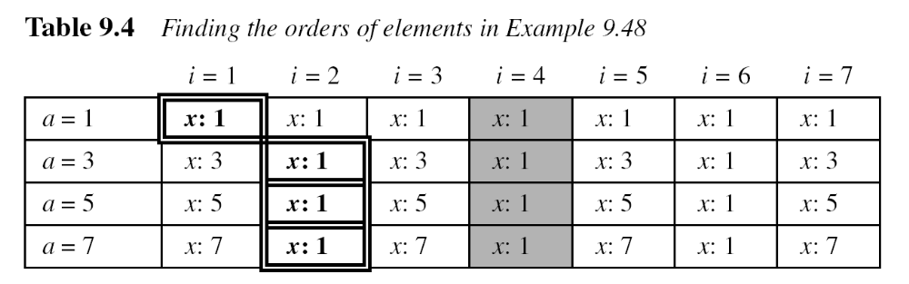
9.6.2 Continued
Euler’s Theorem
Example 9.48
When i = φ(8) = 4, the result is x = 1 for every a.
x can be 1 for many values of i. The first time when x is 1,
the value of i gives us the order ofthe element (double-sided boxes).
The orders of elements are ord(1) = 1, ord(3) = 2, ord(5) = 2, and ord(7) = 2.
9.<number>

Slide 34
9.6.2 Continued
Primitive Roots In the group G = <Z_{n}∗, ×>, when the order of an element is the same as φ(n), that element is called the primitive root of the group.
Example 9.49
Table 9.4 shows that there are no primitive roots in G = <Z₈∗, ×> because no element has the order equal to φ(8) = 4. The order of elements are all smaller than 4.
9.<number>

Slide 35
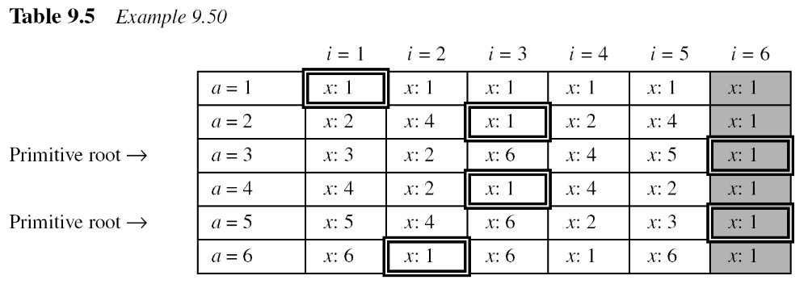
9.6.2 Continued
Example 9.50
Table 9.5 shows the result of a^{i} ≡ x (mod 7) for the group
G = <Z₇∗, ×>. In this group, φ(7) = 6.
9.<number>

Slide 36

9.6.2 Continued
Note
The group G = <Z_{n}*, ×> has primitive roots only if n is 2, 4, p^{t}, or 2p^{t}.
Example 9.51
For which value of n, does the group G = <Z_{n}∗, ×> have primitive roots: 17, 20, 38, and 50?
Solution
G = <Z₁₇∗, ×> has primitive roots, 17 is a prime.
b. G = <Z₂₀∗, ×> has no primitive roots.
c. G = <Z₃₈∗, ×> has primitive roots, 38 = 2 × 19 prime.
d. G = <Z₅₀∗, ×> has primitive roots, 50 = 2 × 5² and 5 is a prime.
9.<number>

Slide 37
9.6.2 Continued
Note
If the group G = <Z_{n}*, ×> has any primitive root, the number of primitive roots is φ(φ(n)).
the number of primitive roots of G = <Z₁₇∗, ×> is??
φ(φ(17)) = φ(16) = 8. Note that we should first check to see if the
group has any primitive root, before we find the number of roots.
9.<number>

Slide 38
Three questions arise!!!!
Given an element a and the group G = <Zn*, ×>, how can we find out whether a is a primitive root of G? This is not an easy task
  We need to find φ(n), which is as difficult as factorization of n.
  We need to check whether ord(a) = φ(n)
2. Given a group G = <Zn*, ×>, how can we check all primitive roots of G? This is more difficult than the first task because we need to repeat part b for all elements of the group
3. Given a group G = <Zn*, ×>, how can we select a primitive root of G? In cryptography, we need to find at least one primitive root in the group. However, in this case, the value of n is chosen by the user and the user knows the value of φ(n). The user tries several elements until he or she finds the first one.
9.<number>

Slide 39
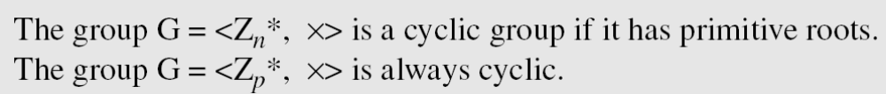
9.6.2 Continued
Cyclic Group If g is a primitive root in the group, we can generate the set Z_{n}* as Z_{n}∗ = {g¹, g², g³, …, g^{φ(n)}}
Each primitive root is a generator and can be used to create the whole set.
In other words, if g is a primitive root in the group
9.<number>

Slide 40
9.6.2 Continued
Example 9.52
The group G = <Z₁₀*, ×> has two primitive roots because φ(10) = 4 and φ(φ(10)) = 2. It can be found that the primitive roots are 3 and 7. The following shows how we can create the whole set Z₁₀* using each primitive root.
9.<number>

Slide 41
9.6.2 Continued
The idea of Discrete Logarithm
Properties of G = <Z_{p}*, ×> :
1. Its elements include all integers from 1 to p − 1.
2. It always has primitive roots.
3. It is cyclic. The elements can be created using g^{x} where
x is an integer from 1 to φ(n) = p − 1.
4. The primitive roots can be thought as the base of logarithm.
9.<number>

Slide 42
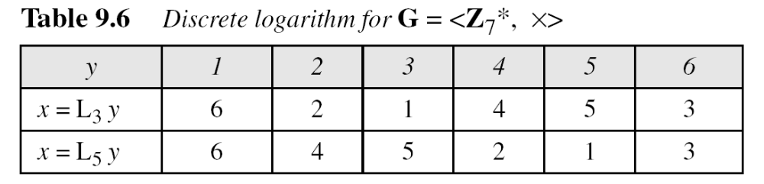
9.6.2 Continued
Solution to Modular Logarithm Using Discrete Logs
Tabulation of Discrete Logarithms
9.<number>

Slide 43
9.6.2 Continued
Example 9.53
Find x in each of the following cases:
a. 4 ≡ 3^{x} (mod 7).
b. 6 ≡ 5^{x} (mod 7).
Solution
We can easily use the tabulation of the discrete logarithm in Table 9.6.
a. 4 ≡ 3^{x} mod 7 → x = L₃4 mod 7 = 4 mod 7
b. 6 ≡ 5^{x} mod 7 → x = L₅6 mod 7 = 3 mod 7
9.<number>

Slide 44
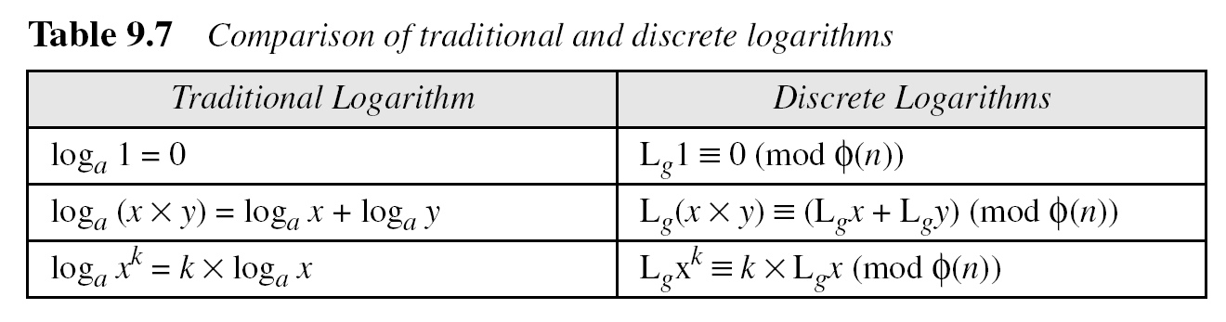
9.6.2 Continued
Using Properties of Discrete Logarithms
Using Algorithms Based on Discrete
Note
The discrete logarithm problem has the same complexity as the factorization problem.
9.<number>

Slide 45
Using Algorithms Based on Discrete Logarithms
Tabulation and the properties of discrete logarithms cannot be used to solve y ≡ a^{x} (mod n) when n is very large.
Several algorithms have been devised that use the basic idea of discrete logarithms to solve the problem.
Although all of these algorithms are more efficient than the exhaustive-search algorithm none of them have polynomial complexity

